Slide 1
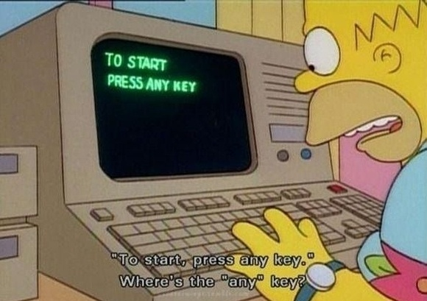
The importance of usability and user experience
for online cultural heritage
Jill Hungenaert
Source: http://www.basicknowledge101.com/subjects/knowledgemanagement.html

Slide 2
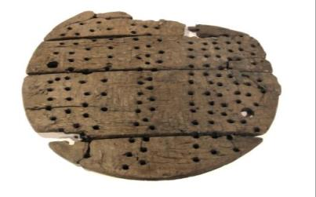
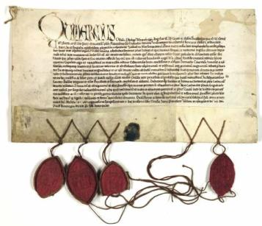
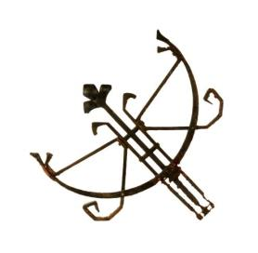
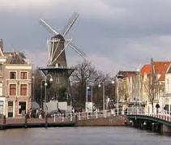
Erfgoed Leiden en Omstreken:
Regional heritage centre (400.000 inhabitants)
Archives, audiovisual materials, archaeological artefacts, building fragments
Advice on city development, restoration and use of monuments, archaeological excavations
Windmill museum
Educational activities
Notes:
What is Heritage Leiden? 30 seconds.
Plus: 60 employees, 85 volunteers

Slide 3

Empowering​ Communities​ with a​ Heritage​ Open​ EcoSystem

Slide 4
If we build it,
they will come.
Notes:
What is Heritage Leiden? 30 seconds.
Plus: 50 employees,

Slide 5
If they need it
and we build it,
they will come.
Notes:
What is Heritage Leiden? 30 seconds.
Plus: 50 employees,

Slide 6
If they need it
and we build it,
they will might come.
Notes:
What is Heritage Leiden? 30 seconds.
Plus: 50 employees,

Slide 7
If they need it
and we build it,
they might come.
If it offers a good user experience they might stay.
Notes:
What is Heritage Leiden? 30 seconds.
Plus: 50 employees,

Slide 8
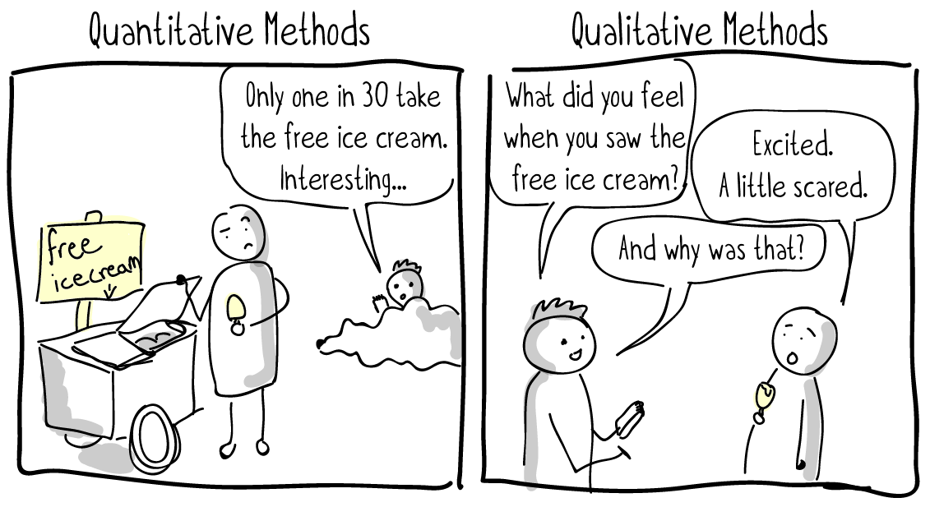
Source: https://uxdesign.cc/a-crash-course-in-ux-design-research-ea00c3307c82

Slide 9
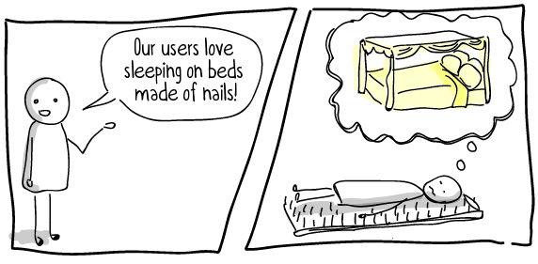
Source: https://uxdesign.cc/a-crash-course-in-ux-design-research-ea00c3307c82

Slide 10
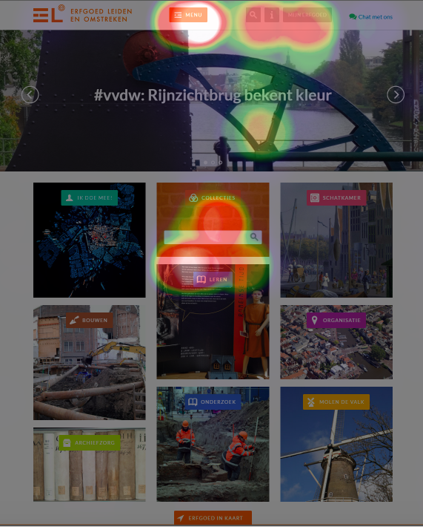

Slide 11
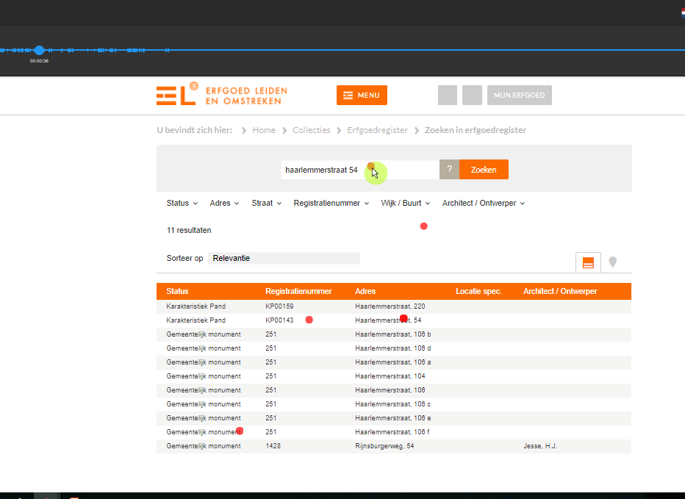

Slide 12


Slide 13
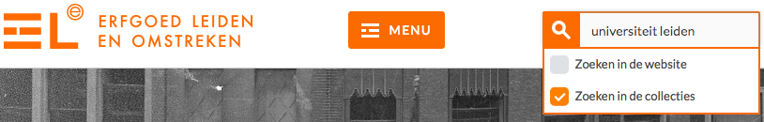

Slide 15
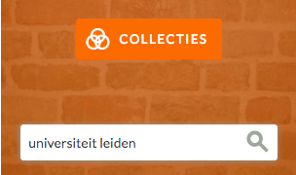

Slide 16
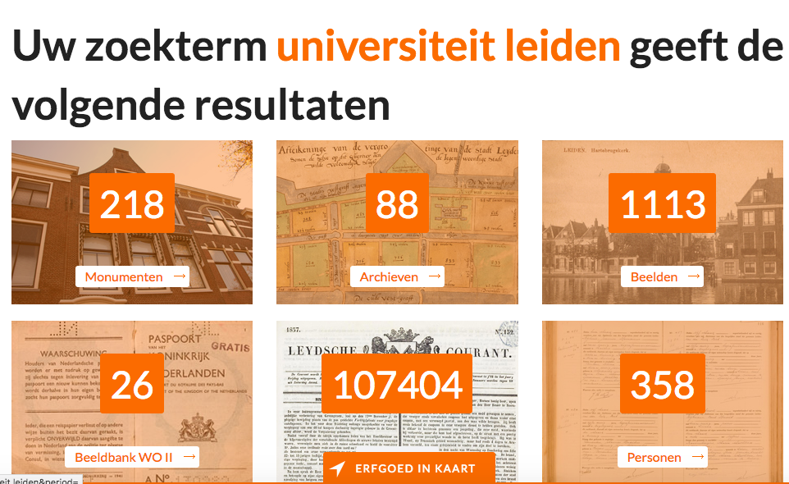

Slide 17
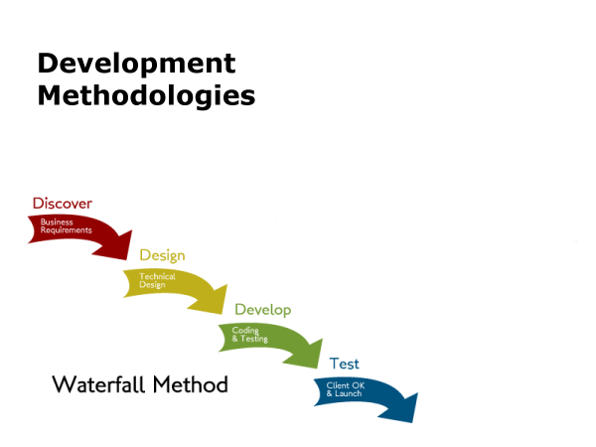
Source: www.careerinsights.tv/whats-the-difference-between-waterfall-agile-when-do-you-use-each-one

Slide 18
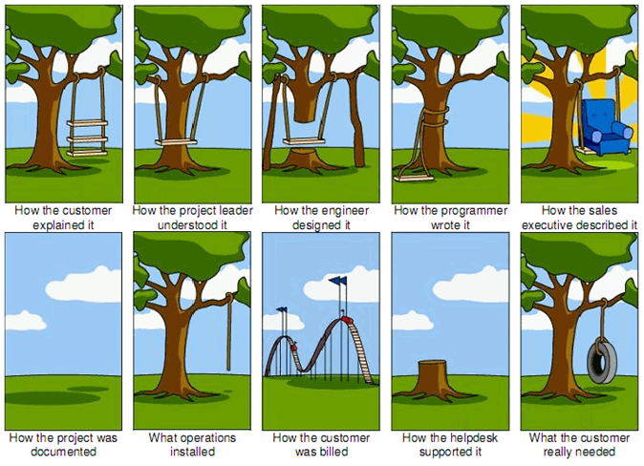

Slide 19
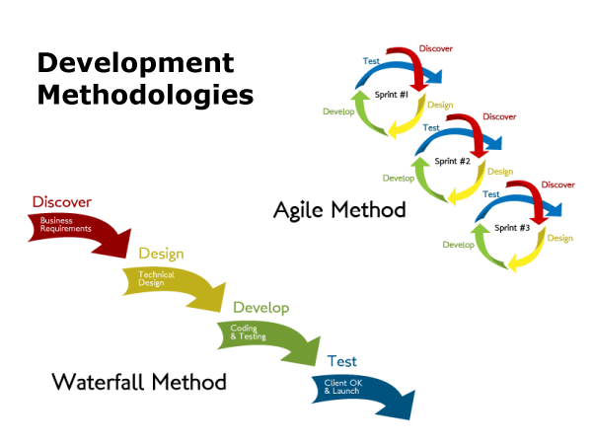
Source: www.careerinsights.tv/whats-the-difference-between-waterfall-agile-when-do-you-use-each-one

Slide 20
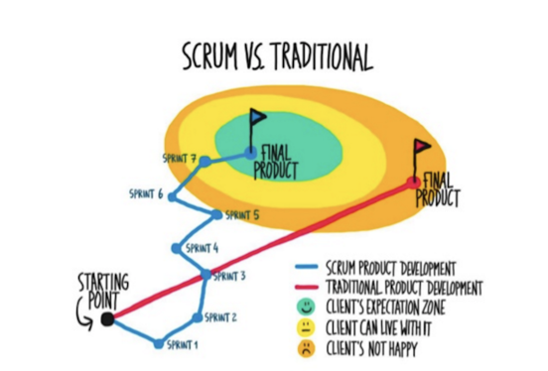
Notes:
ECHOES is developed using Agile programming

Slide 21
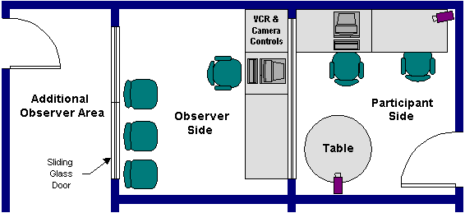
Source: http://grouplab.cpsc.ucalgary.ca/saul/681/1997/jas/labs.html

Slide 22

Source: http://www.uxteam.com/usability-testing-evaluations/

Slide 23
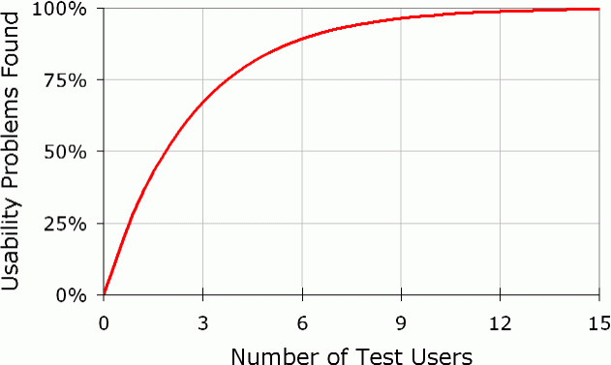
Source: https://www.nngroup.com/articles/why-you-only-need-to-test-with-5-users/

Slide 24
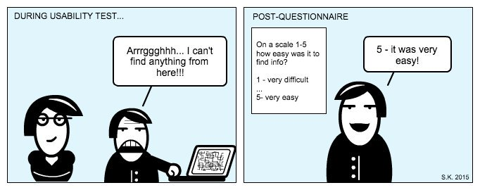
Source: https://twitter.com/solidabis/status/939035983772762113

Slide 25
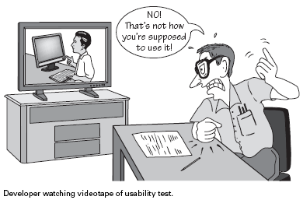
Source: https://uxdesign.cc/data-for-design-f33fd7419cc8

Slide 26
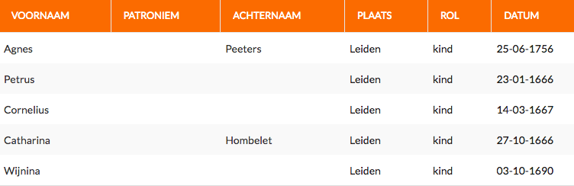

Slide 27
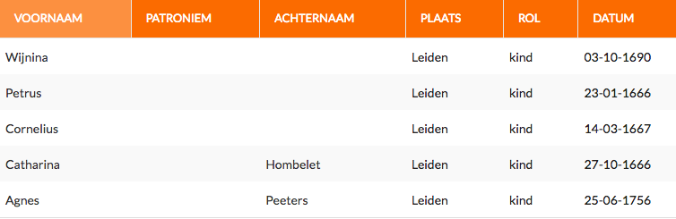

Slide 28
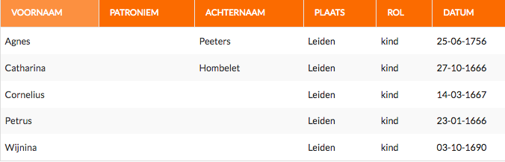

Slide 29
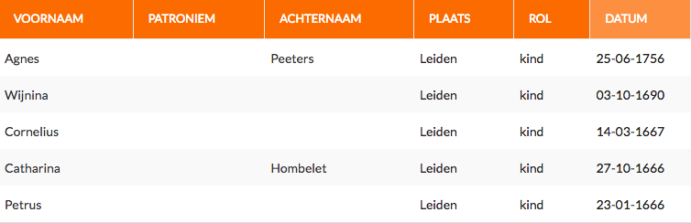

Slide 30
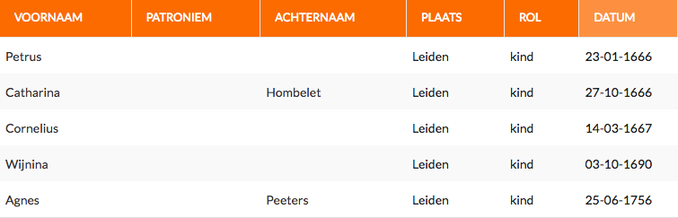

Slide 31
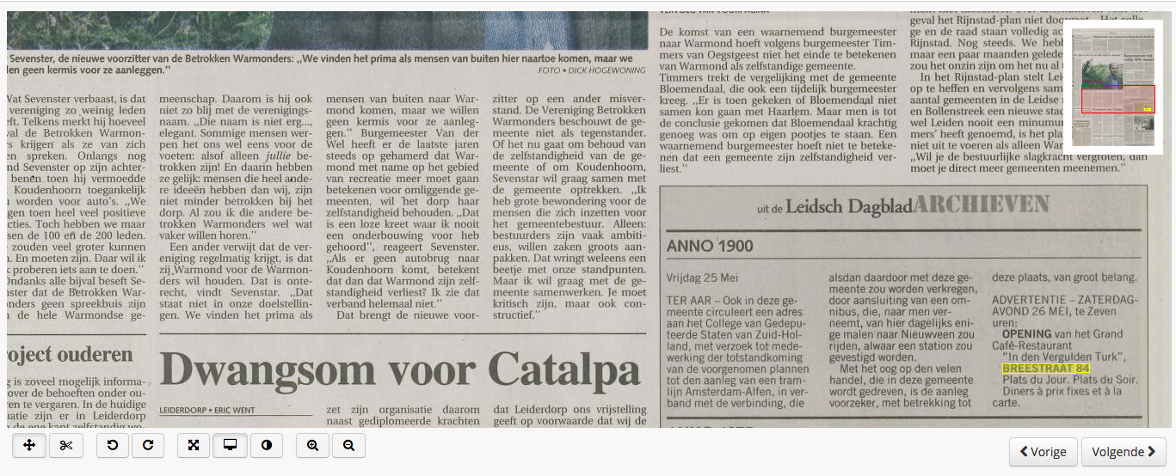

Slide 32
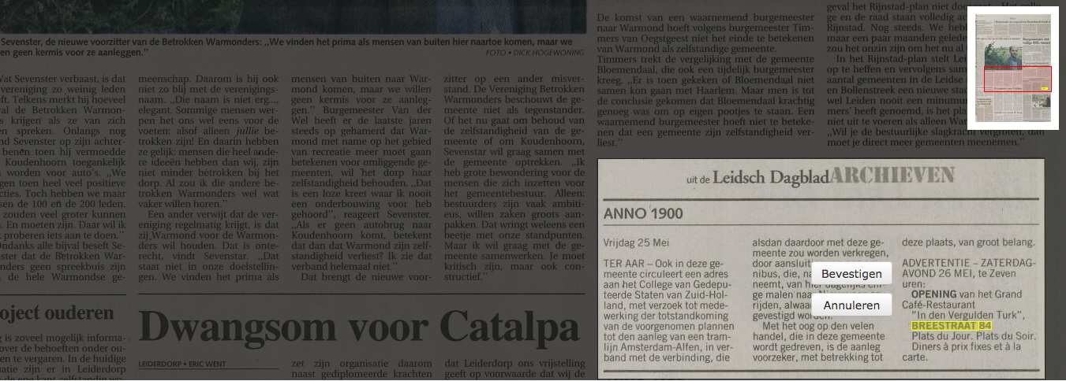

Slide 33
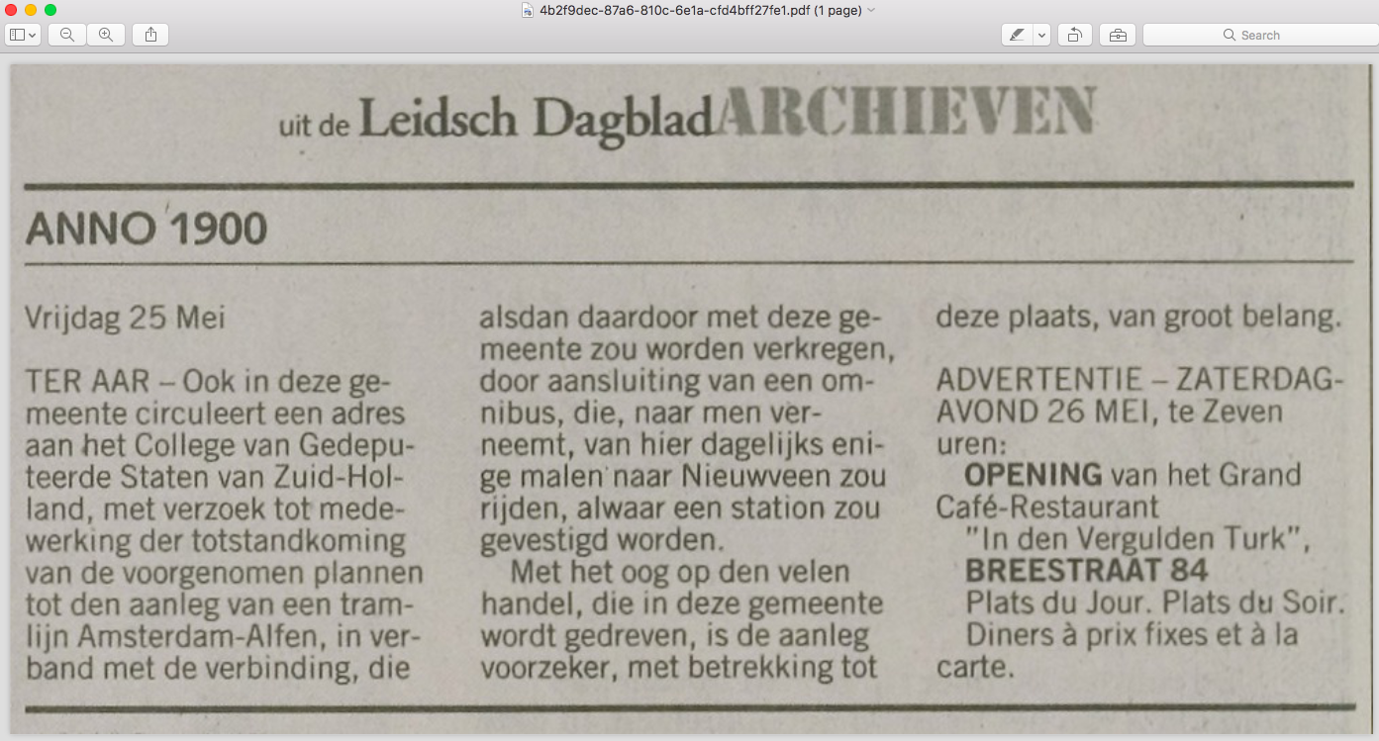

Slide 34
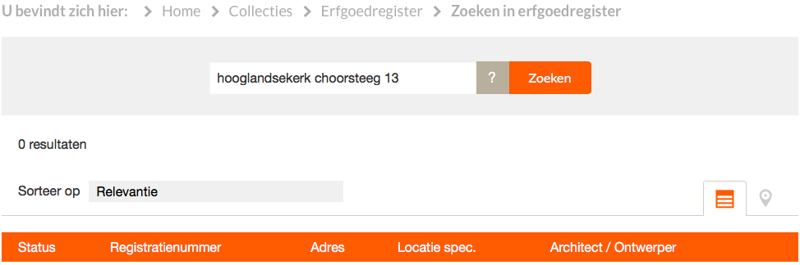

Slide 35
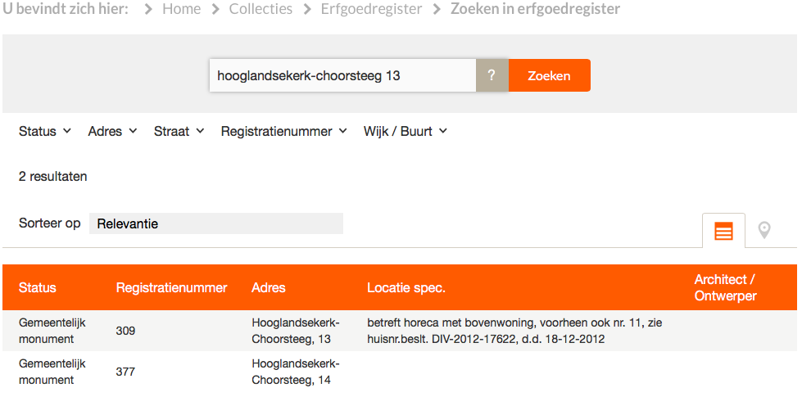

Slide 36
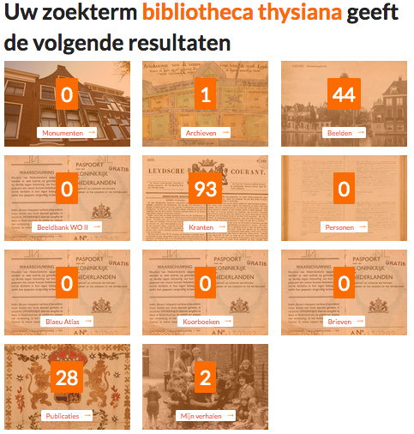

Slide 37
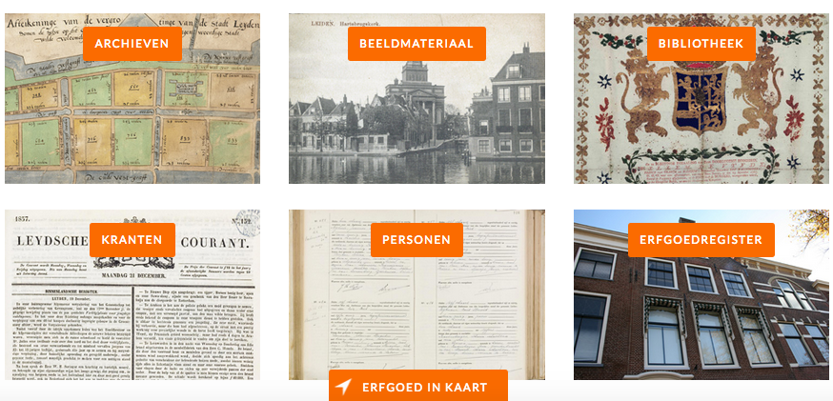

Slide 39
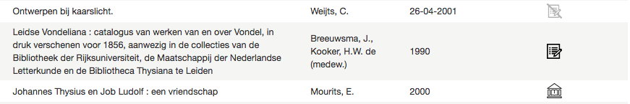

Slide 40
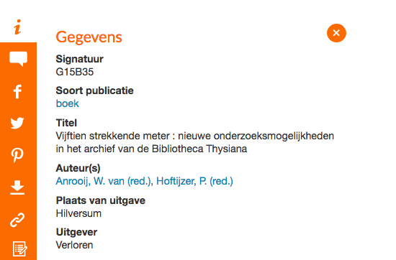

Slide 41
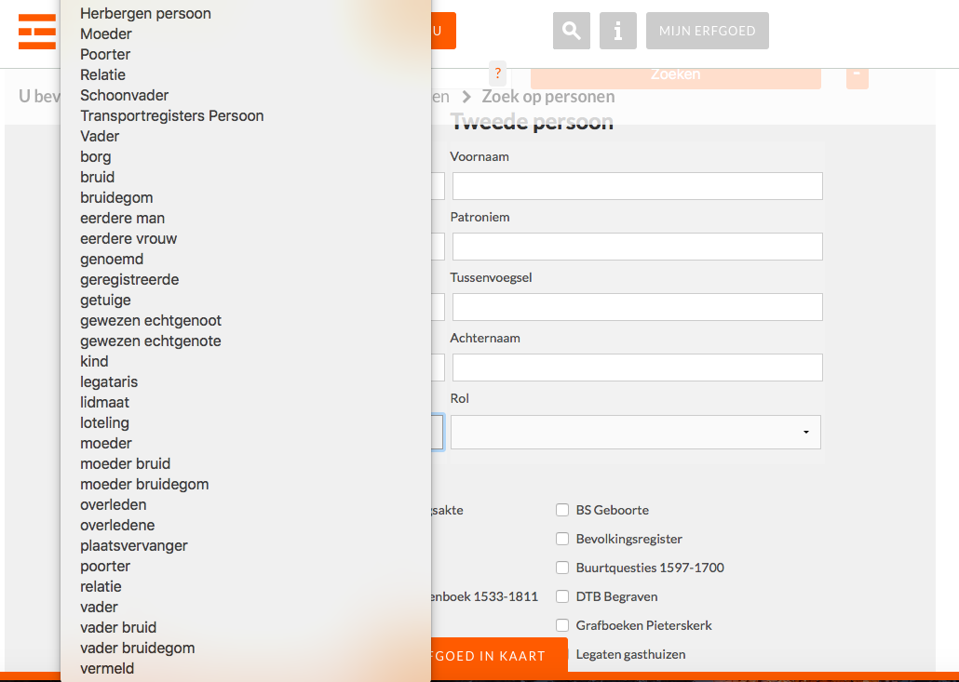

Slide 42
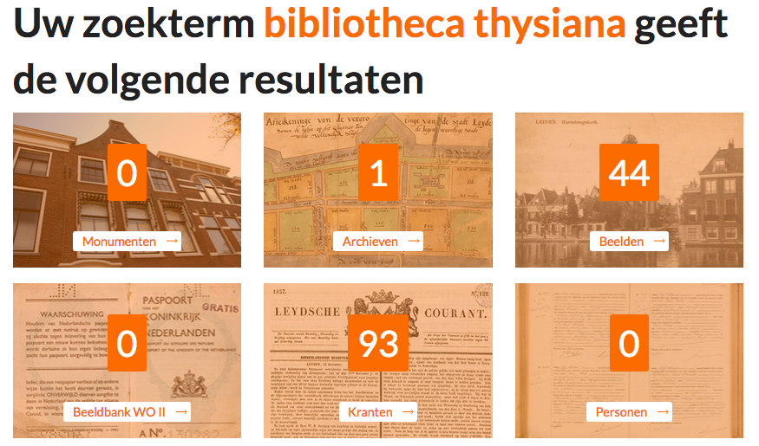

Slide 43
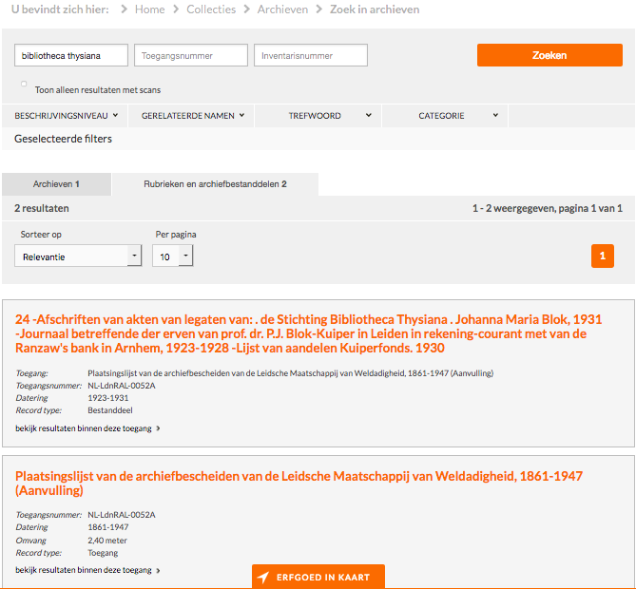

Slide 44
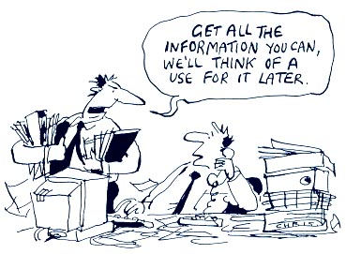
Source: https://uxdesign.cc/data-for-design-f33fd7419cc8

